Slide 1
End-to-End FMCG Retail Sales Analytics Project Powered by Excel | SQL | Python | Power BI
A complete data analytics project covering data cleaning, transformation, analysis, and dashboard creation for FMCG retail sales.
Work Flow: Excel → SQL → Python → Power BI → Insights
Prepared by: Ali Khanbeigi

Slide 2
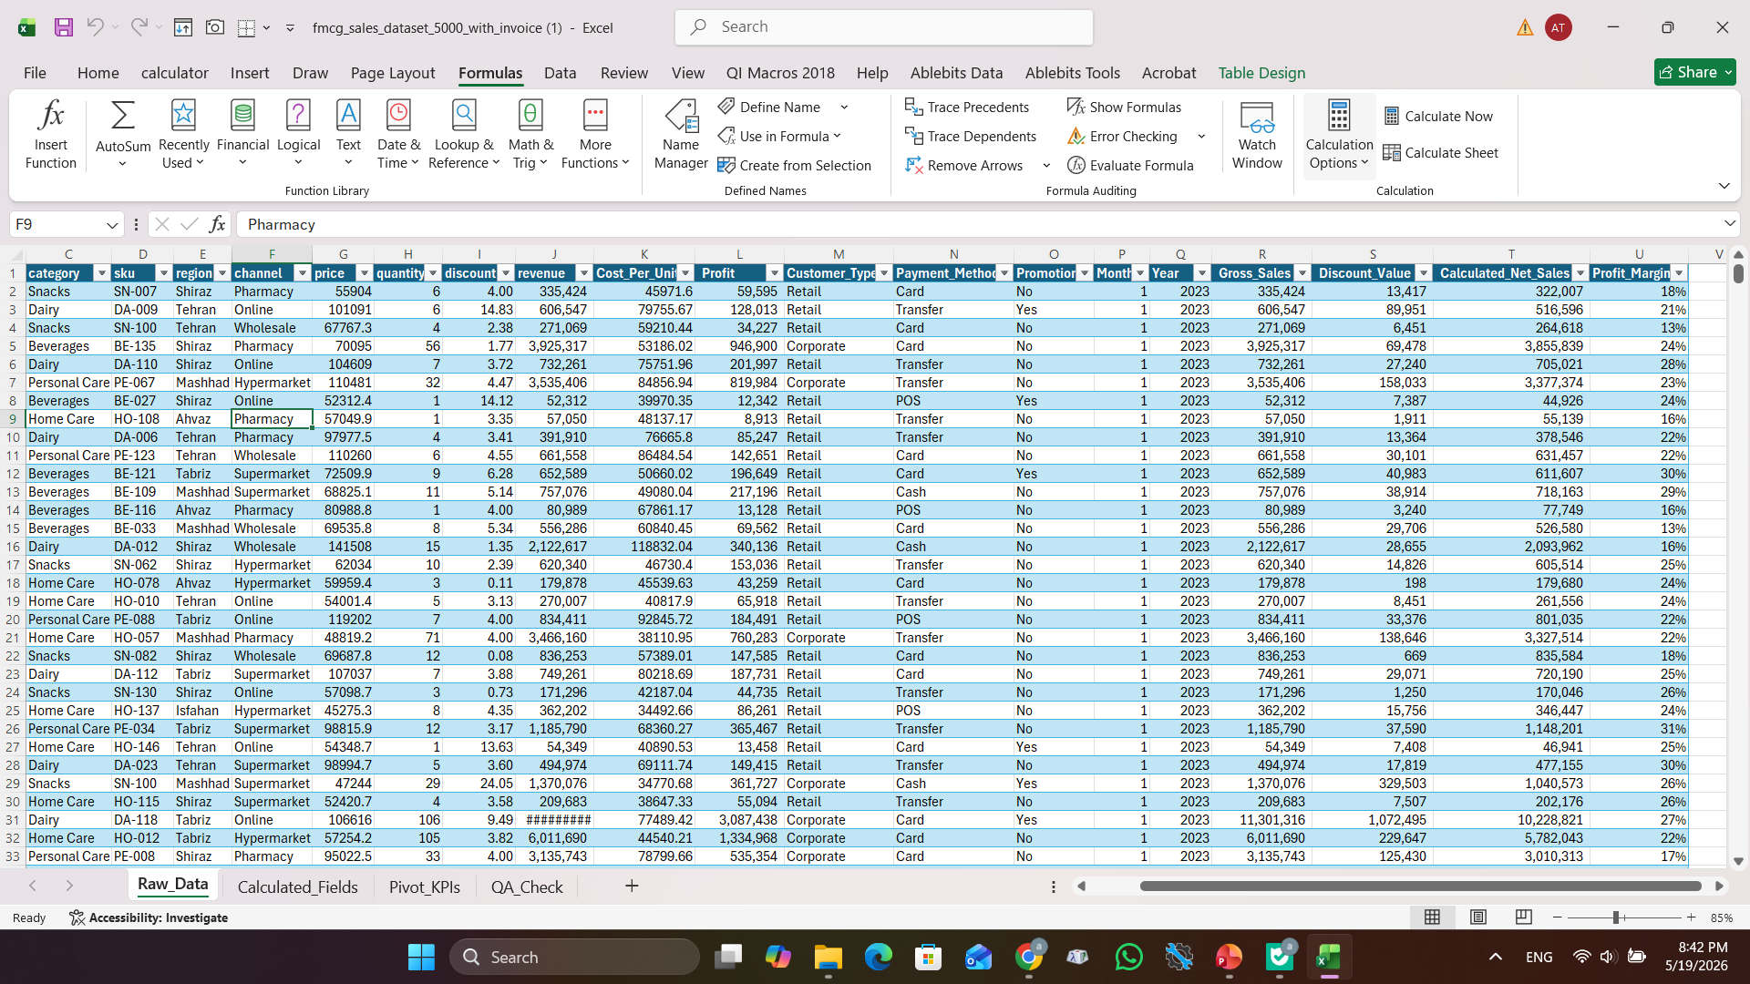
1. Excel Stage:
1. Data Review & Initial Cleaning
Field | Description
Project Domain | FMCG / Retail Sales
Objective | Analyze product, region, and channel performance
Dataset Source | CSV
Tools (Pipeline) | Excel ⇢ SQL ⇢ Python ⇢ Power BI
Record Count | ~5K transactions
Time Range | Apr 2026 – Mar 2026
sheets | Rowdata-Calculated fields-Pivot KPI- QA Check

Slide 3
1. Excel Stage:
2. Calculated Fields: Adding some crucial fields and KPIs to the table
Field Name | Formula Example | Description
Gross_Sales | =[@price]*[@quantity] | Total revenue before discount
Discount_Value | =[@Gross_Sales]*([@discount]/100) | Monetary value of discount
Calculated_Net_Sales | =[@Gross_Sales]-[@Discount_Value] | Net sales after discount
Profit_Margin | =[@profit]/[@revenue] | Margin ratio

Slide 4
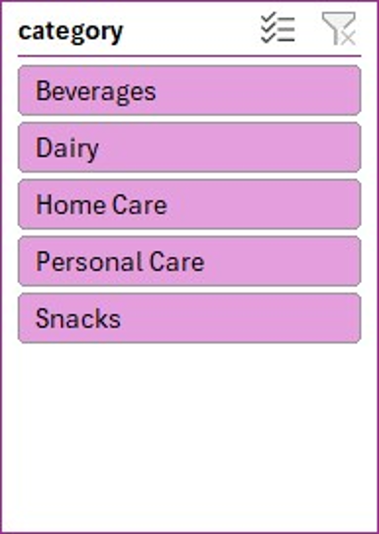
1. Excel Stage:
3. Pivot KPI: This pivot table provides an initial summary of sales and profitability by product category, helping identify top‑performing segments before moving to deeper analysis in another stages. For example:
category | Sum of revenue | Sum of Profit
Beverages | 1,676,337,233 | 396,218,459
Dairy | 2,529,114,293 | 586,011,200
Home Care | 1,216,291,730 | 288,819,856
Personal Care | 2,507,200,832 | 575,251,609
Snacks | 1,537,237,687 | 360,499,833
Grand Total | 9,466,181,774 | 2,206,800,957
Pivot table
Bar chart
Slicer
This pivot table calculates total revenue and profit across product categories, allowing quick comparison of financial performance between segments. There are some other pivot tables like: sum profit and sum revenue by region, channel, year and month, promotion,….

Slide 5
1. Excel Stage:
3. QA Check : Performed data QA checks to ensure completeness, accuracy, and consistency before loading into Power BI.
Revenue Check | Mismatch | Formula
Negative Profit | OK | =IF(COUNTIF(SALES_DATA[Profit], "<0")=0, "OK", "Found Negative Profit")
Max Profit | 5,150,518 | =MAX(SALES_DATA[Profit])
Min Profit | 6,117 | =MIN(SALES_DATA[Profit])
Min Revenue | 38,398 | =MIN(SALES_DATA[revenue])
Max Revenue | 18,346,547 | =MAX(SALES_DATA[revenue])
Total Orders | 5000 | -
Validated key columns, checked for duplicates, and confirmed category mappings were correct.
Reviewed calculated fields and pivot outputs to verify correctness of revenue and profit logic.
Ensured no missing values and standardized formatting across all source tables.
QA Table

Slide 6
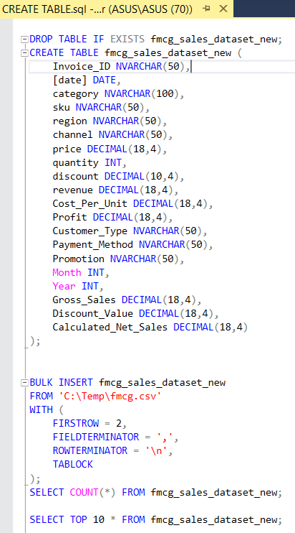
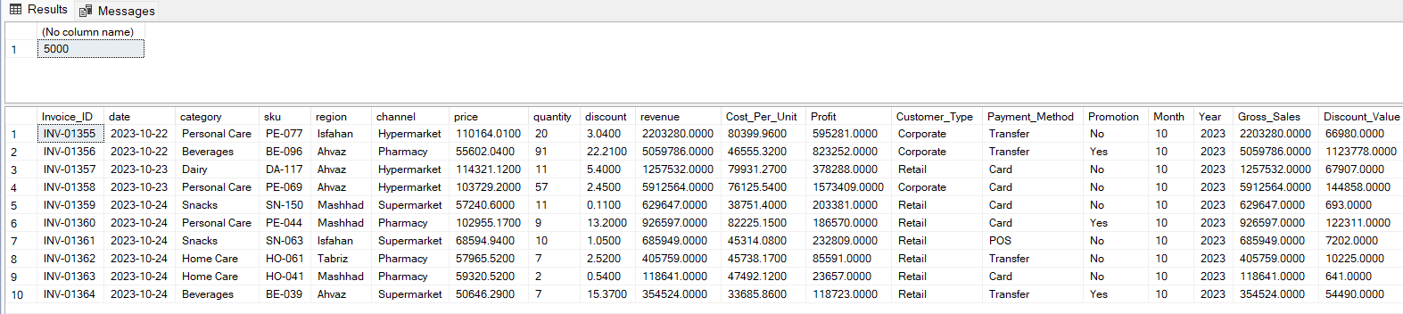
2. SQL Stage(SQL Server):
1. Data Import & Table Creation
Created a structured SQL table and imported raw FMCG sales data using BULK INSERT to enable efficient querying and validation before analysis.

Slide 7
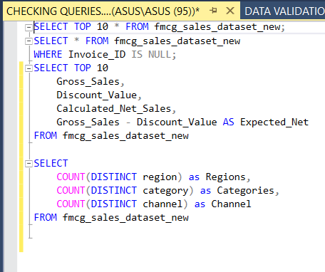
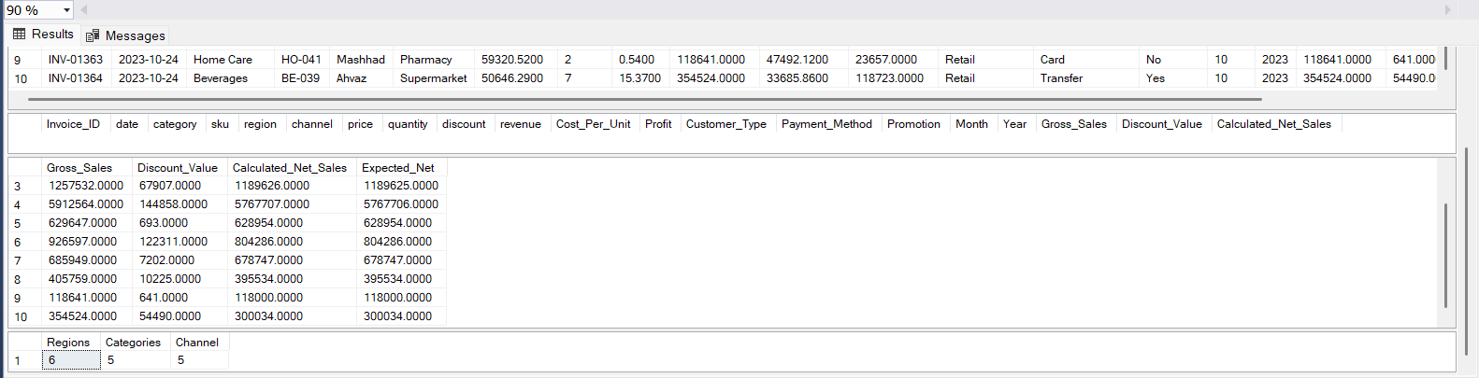
2. SQL Stage(SQL Server):
2. Data Validation & Quality Checks – SQL
Previewed imported data to verify structure
Checked for missing primary identifiers
Validated financial calculations (Net Sales logic)
Reviewed distinct values across key business dimensions

Slide 8
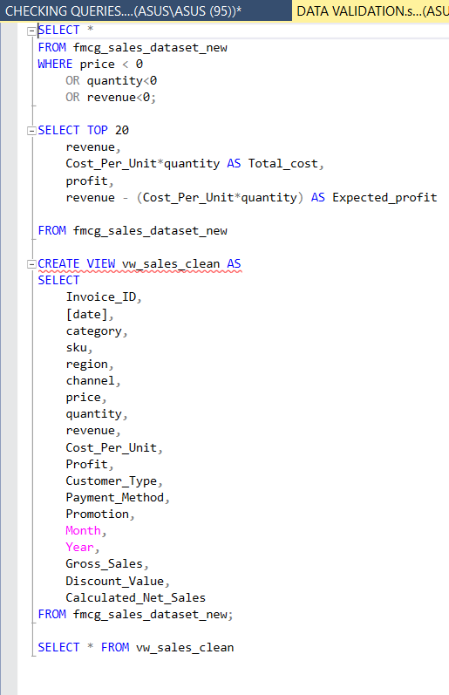
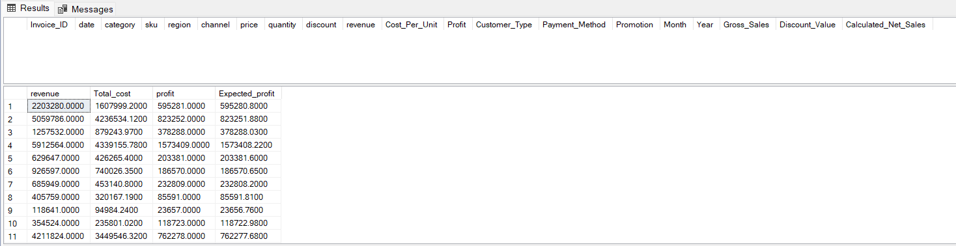
2. SQL Stage(SQL Server):
3. Business Logic Validation & Data Modeling
• Recalculated and validated profit logic
• Cross-checked revenue and cost consistency
• Created a clean SQL view for reporting
• Prepared structured dataset for Power BI modeling

Slide 9
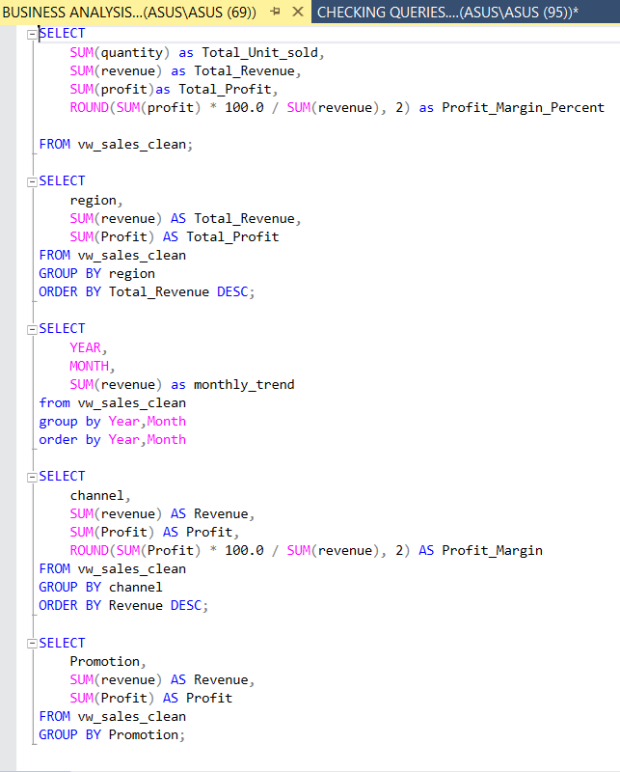
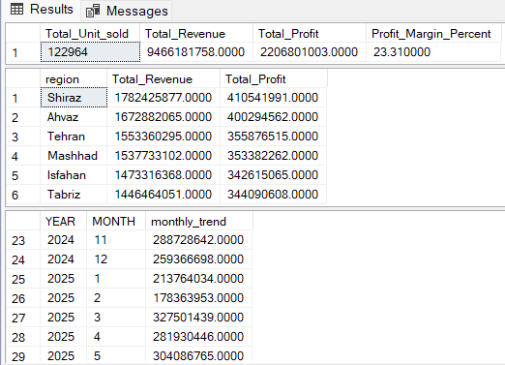
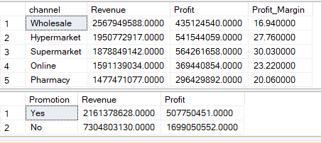
2. SQL Stage(SQL Server):
4. Exploratory Data Analysis (EDA) – SQL Insights
• Computed key KPIs (Revenue, Profit, Margin) from cleaned data
• Analyzed sales performance across Regions & Channels
• Built Monthly trend for time-series visualization
• Evaluated Promotion effectiveness and profitability impact

Slide 10
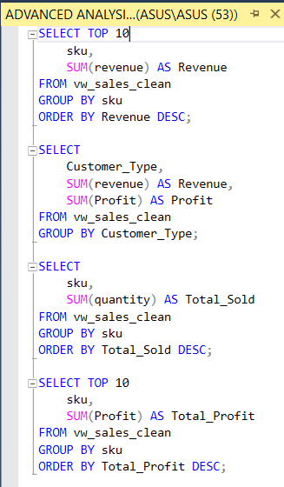
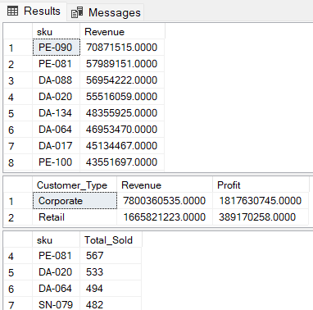
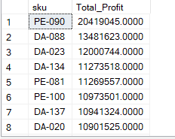
2. SQL Stage(SQL Server):
5. Product & Customer Performance Analysis
• Identified top revenue-generating SKUs
• Compared customer segment profitability
• Distinguished between high-volume and high-margin products
• Highlighted strategic products driving overall business performance

Slide 11
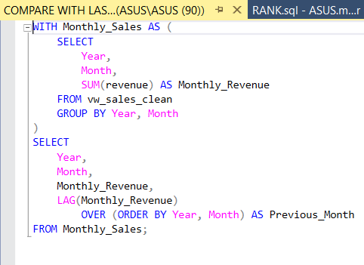
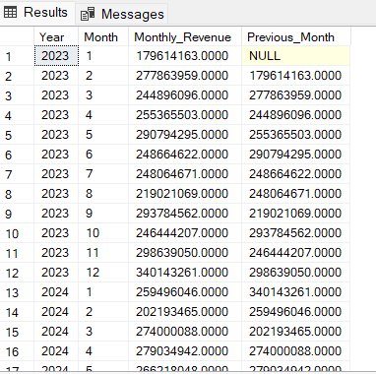
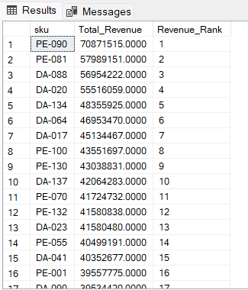
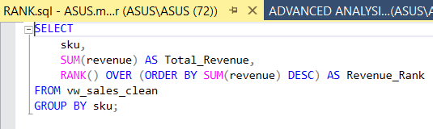
2. SQL Stage(SQL Server):
6. Advanced SQL Analysis – Trend & Ranking Insights
• Applied CTE & window functions (LAG, RANK) for dynamic trend and ranking insights
• Built month-over-month revenue comparisons to spot performance shifts
• Ranked SKUs by total revenue to highlight top performers
• Demonstrated advanced SQL analytical capability ready for BI modeling

Slide 12
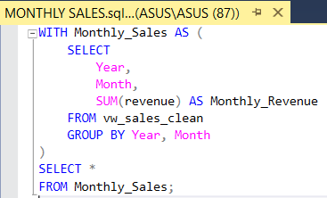
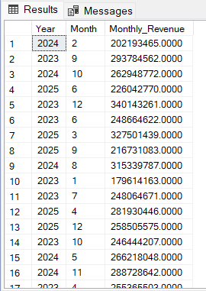
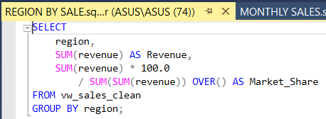
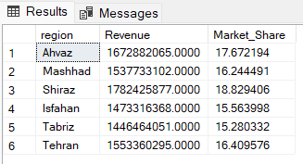
2. SQL Stage(SQL Server):
7. Advanced SQL Analysis – Market Share & Structured Aggregations
• Computed regional market share using window functions
• Applied proportional revenue contribution analysis
• Built structured monthly aggregation using CTE
• Demonstrated advanced SQL modeling and analytical thinking

Slide 13
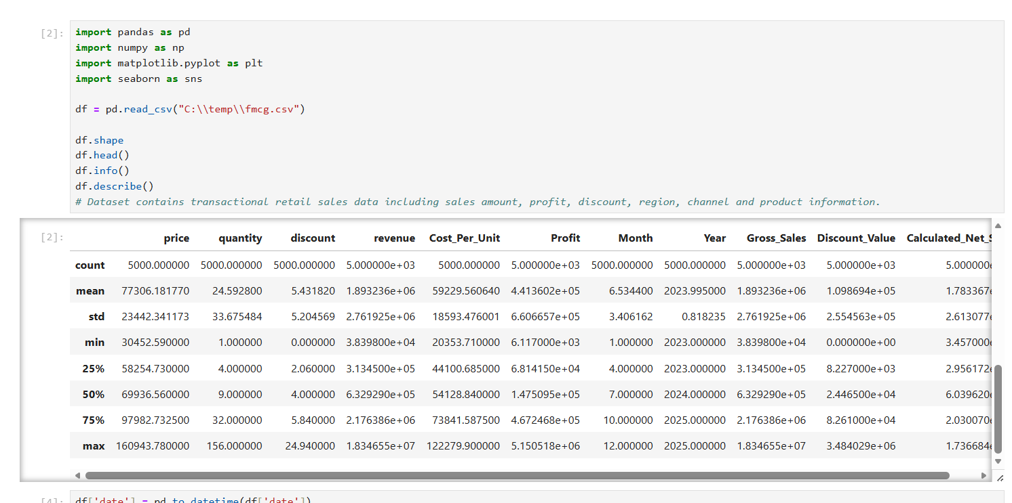
3. PYTHON Stage:
Loaded and explored the FMCG sales dataset using pandas, numpy, matplotlib, and seaborn.
Checked data structure and quality with .shape, .head(), and .info().
Generated summary statistics using .describe() to understand distribution, spread, and possible outliers.
Prepared the data for further cleaning and analysis before building dashboards in Power BI.

Slide 14
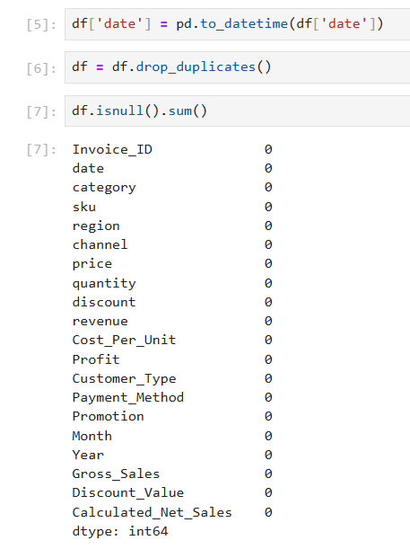
3. PYTHON Stage:
Data Transformation: Converted date column to datetime objects for time-series analysis.
Data Deduplication: Removed duplicate records to ensure data integrity and accurate aggregation.
Null Value Assessment: Audited missing values to determine necessary cleaning or imputation strategies.

Slide 15
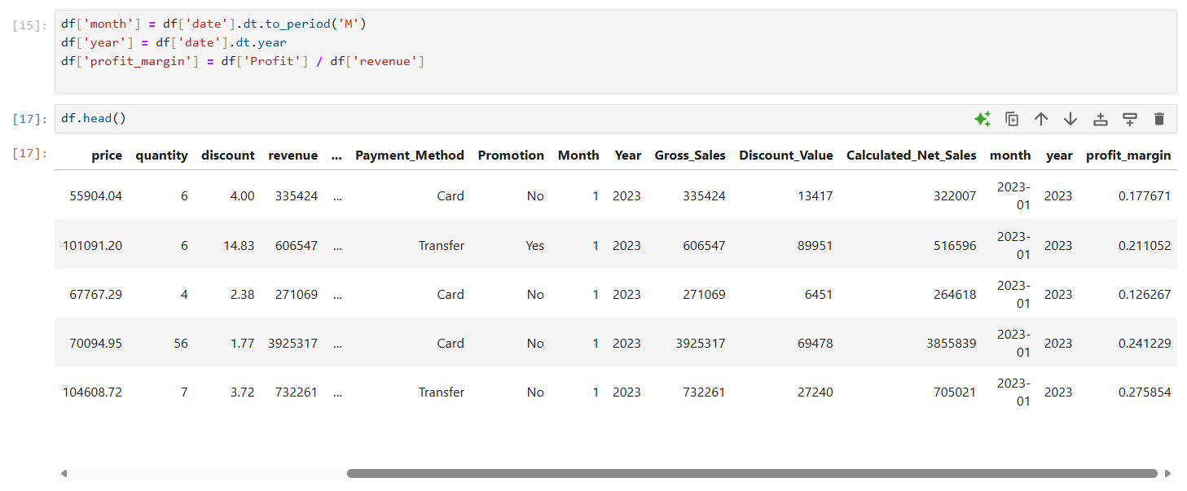
3. PYTHON Stage:
Temporal Feature Extraction: Extracted month and year attributes to enable time-based trend analysis and seasonality comparisons.
KPI Creation: Calculated profit_margin as a derived metric to quantify operational efficiency and profitability trends.

Slide 16
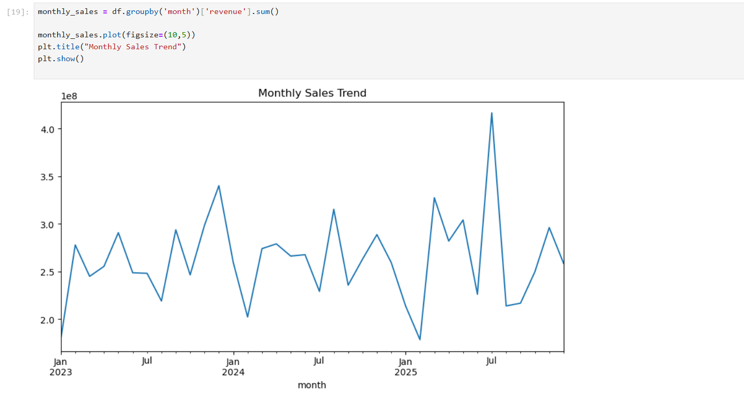
3. PYTHON Stage:
Time-Series Analysis: Performed group-based aggregation to visualize monthly_sales trends over time.
Trend Visualization: Identified growth patterns and seasonal fluctuations, serving as a foundational input for business forecasting and decision-making.

Slide 17
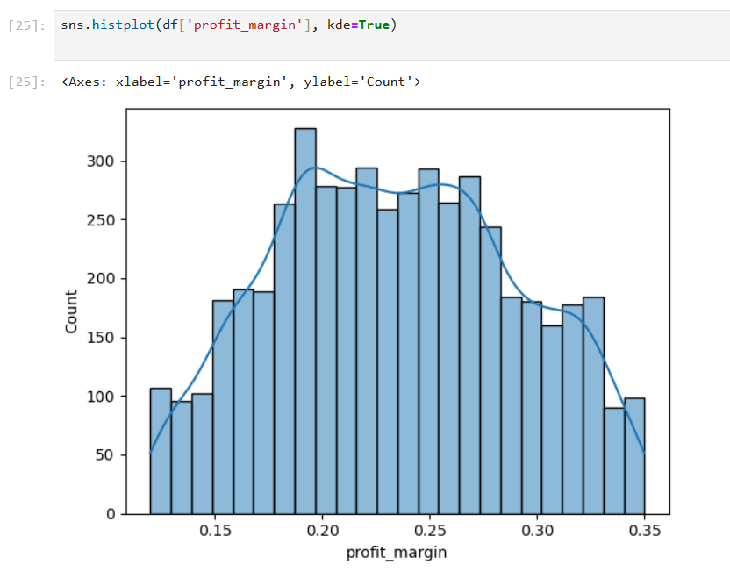
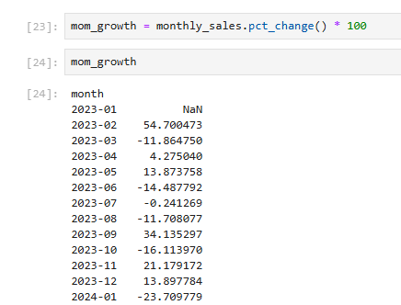
3. PYTHON Stage:
Performance Analytics: Calculated Month-over-Month (MoM) growth rates to quantify business momentum and volatility.
Statistical Profiling: Used histogram and KDE plots to analyze the distribution of profit_margin, identifying outliers and assessing profitability consistency.

Slide 18
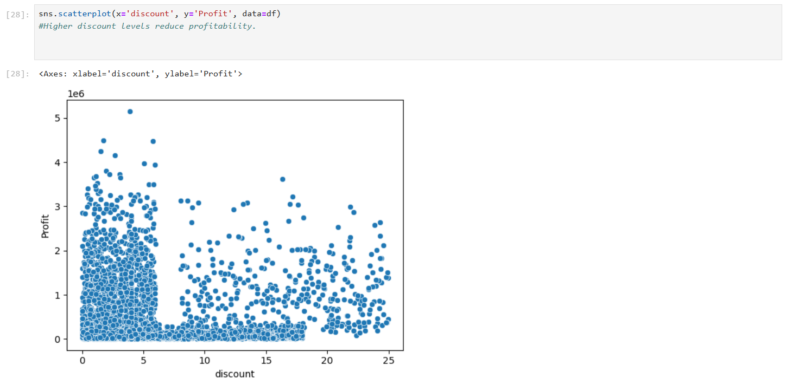
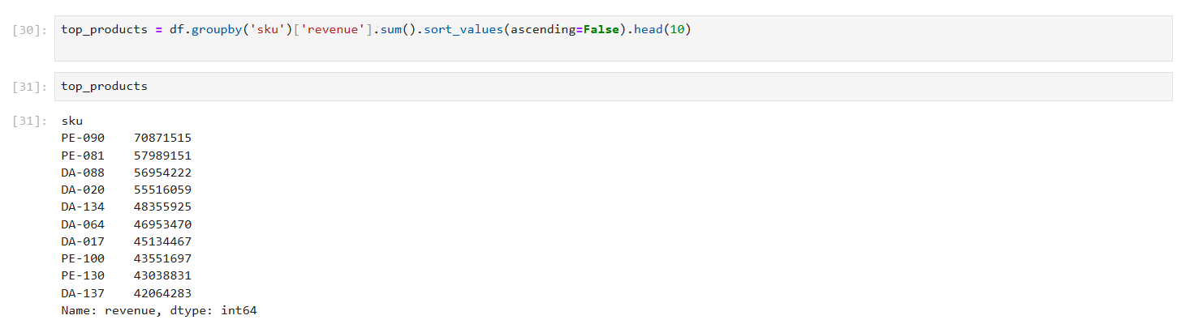
3. PYTHON Stage:
Discount vs Profit Analysis: Used a scatter plot to examine the relationship between discount and Profit, revealing that higher discount levels tend to compress profitability.
Top-Selling Product Identification:
Aggregated revenue by sku and ranked products to identify the top 10 revenue-generating items, supporting product performance analysis and inventory prioritization.

Slide 19
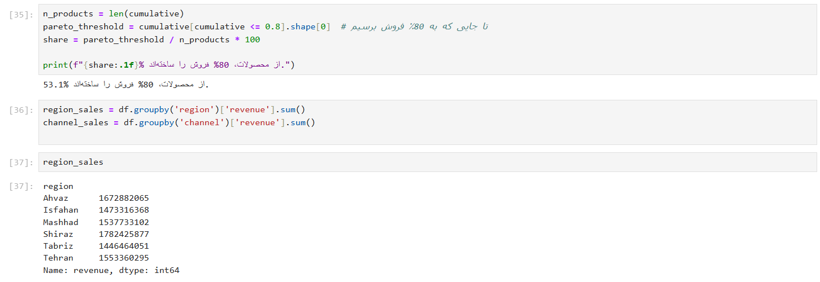
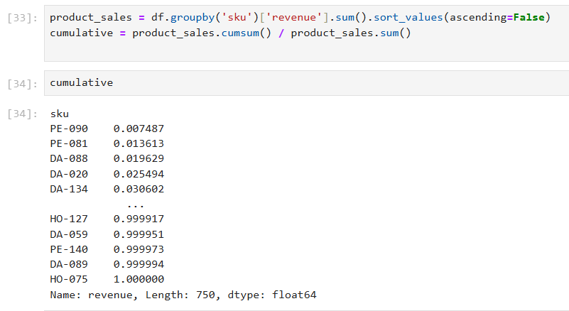
3. PYTHON Stage:
Pareto Principle (80/20 Rule) Application: Performed a concentration analysis to determine which percentage of products contribute to 80% of total revenue.
Strategic Insights: Identified key product drivers, enabling resource optimization and improved inventory focus.

Slide 20
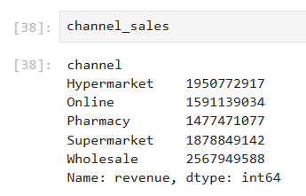
3. PYTHON Stage:
Regional Revenue Analysis:
Aggregated revenue by region to compare performance across geographic markets and identify high-earning regions.
Channel Performance Analysis:
Aggregated revenue by channel to evaluate which sales channels contribute most to total revenue and support distribution strategy decisions.

Slide 21
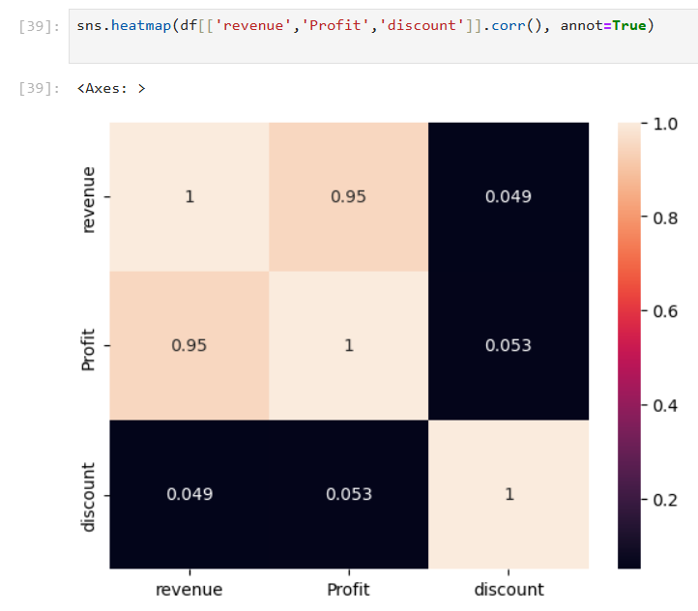
3. PYTHON Stage:
Multivariate Correlation Analysis:
Utilized correlation matrix and heatmaps to investigate relationships between key business metrics (revenue, profit, discount).
Data-Driven Discovery:
Identified the strength of correlation between revenue and profit margins, providing insights for pricing and discount policy optimization.

Slide 22
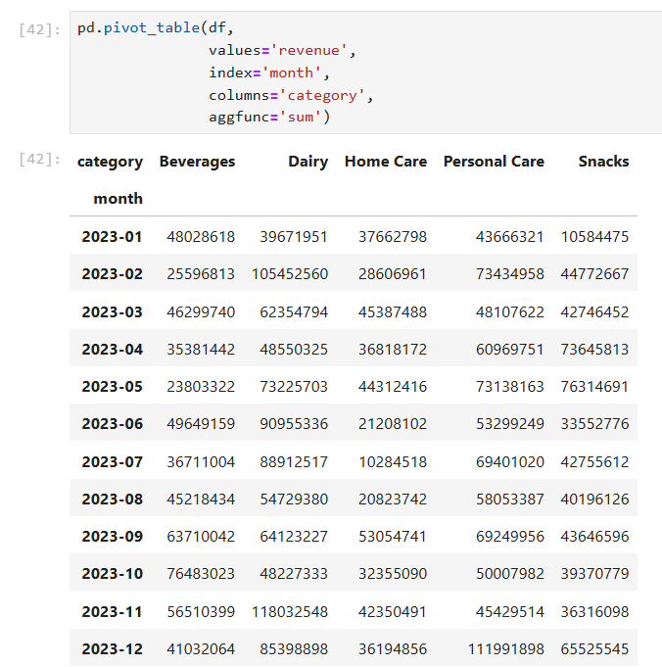
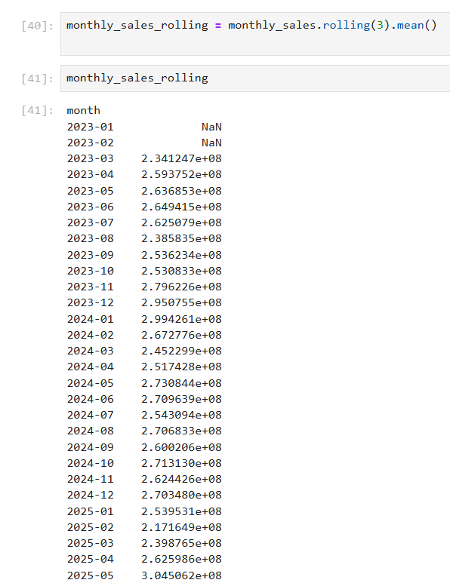
3. PYTHON Stage:
Rolling Average Analysis: Smoothed monthly revenue trends using a 3-month moving average.
Pivot-Based Segmentation: Compared monthly sales performance across product categories using a pivot table.

Slide 23
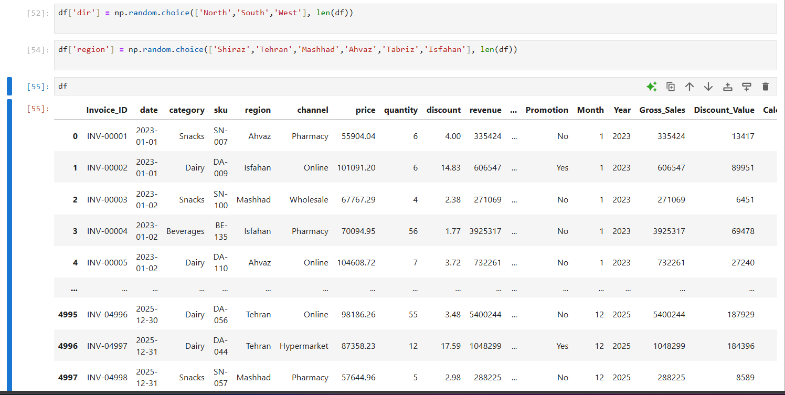
3. PYTHON Stage:
Synthetic Data Generation: Implemented random sampling to create categorical variables (direction, region), simulating realistic regional and spatial data distributions.
Data Augmentation: Enhanced existing datasets with additional dimensions to enable multi-faceted geographical and directional business analysis.

Slide 24
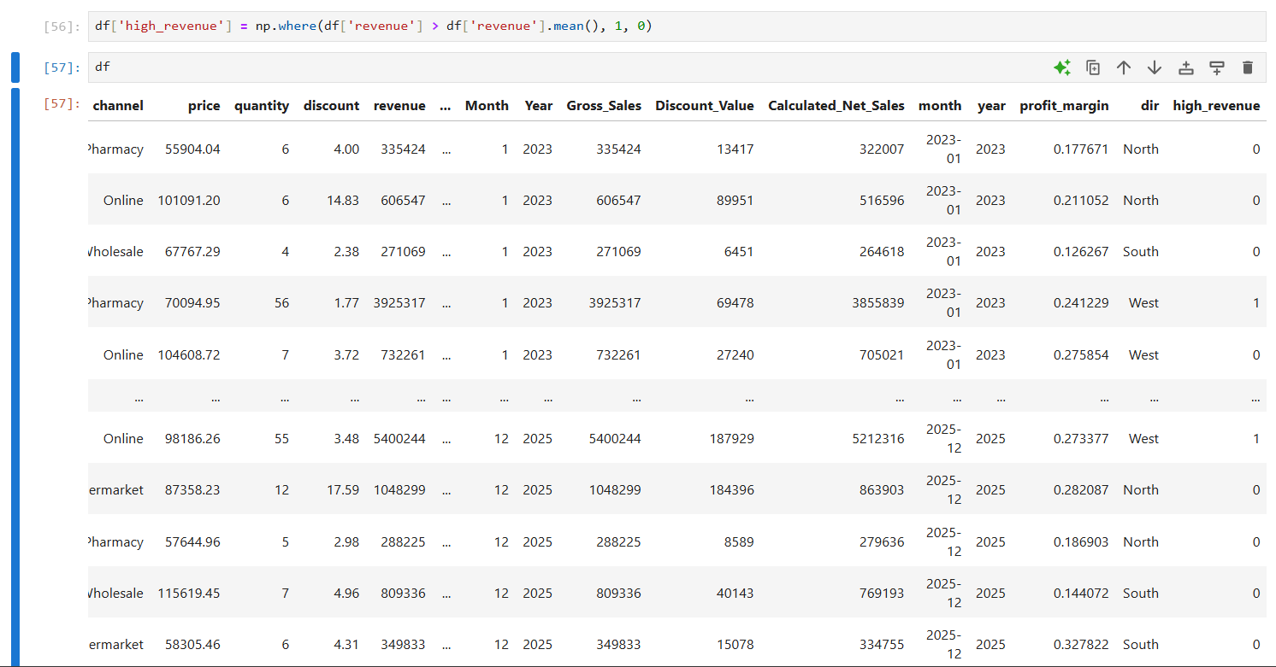

3. PYTHON Stage:
Feature Engineering: Engineered a binary classification feature (high_revenue) based on the revenue mean threshold, enabling targeted analysis of high-performing segments.
Data Exporting: Automated the pipeline by exporting the processed, enriched dataset to Excel for final dashboarding and visualization in Power BI.

Slide 25
4. POWER BI Stage:
Some calculated KPI(measures) in power bi:
KPI | DAX FORMULA
Total Orders | Total Orders = DISTINCTCOUNT(fmcg_sales_dataset_new[Invoice_ID])
Total Profit | Total Profit = SUM(fmcg_sales_dataset_new[profit])
Total sales | Total_sales = sum(fmcg_sales_dataset_new[revenue])
MoM Growth % | MoM Growth % = DIVIDE( [Total_Sales] - [Previous Month Sales], [Previous Month Sales] )
AOV | AOV = DIVIDE([Total_sales], [Total Orders])

Slide 26
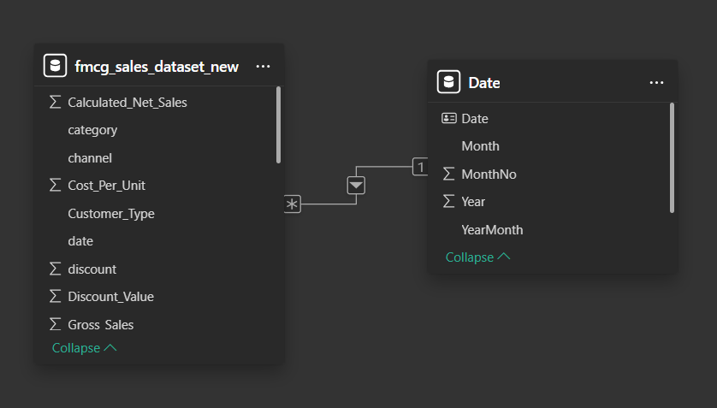
4. POWER BI Stage:
Generate a date table based on the main database and modeling-related data.

Slide 27
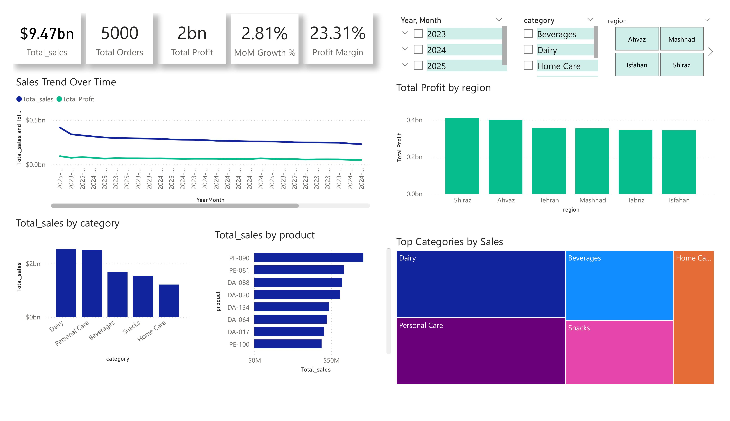
4. POWER BI Stage:
Page 1: Overview

Slide 28
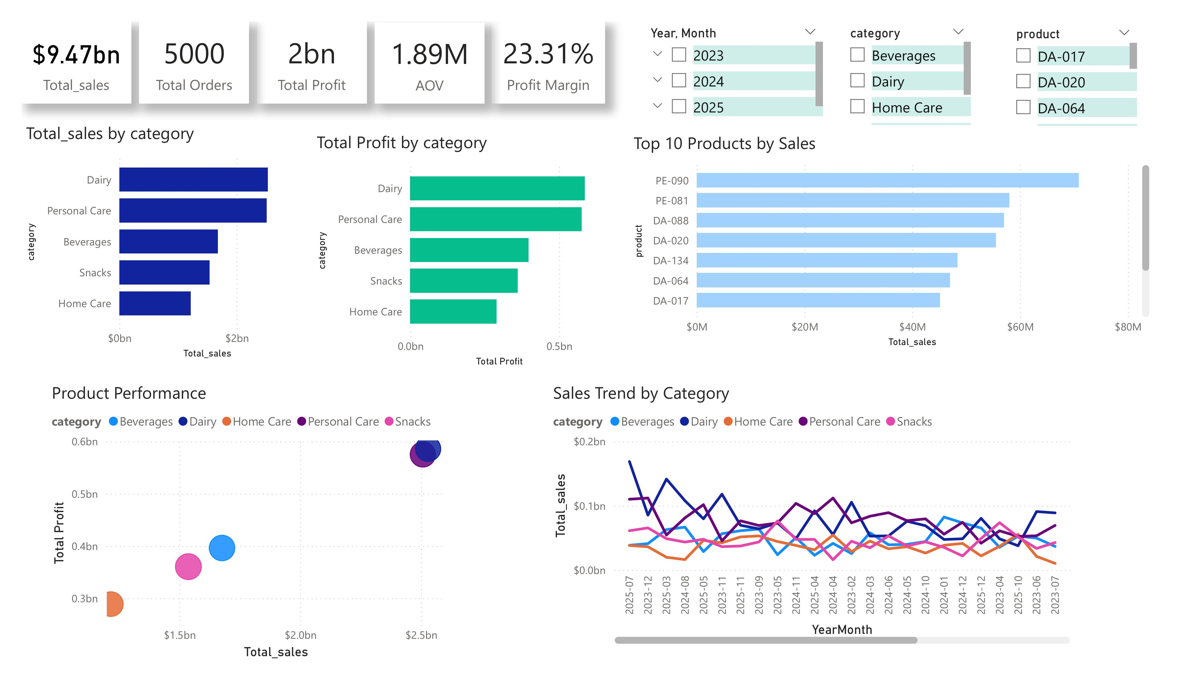
4. POWER BI Stage:
Page 2: category analysis

Slide 29
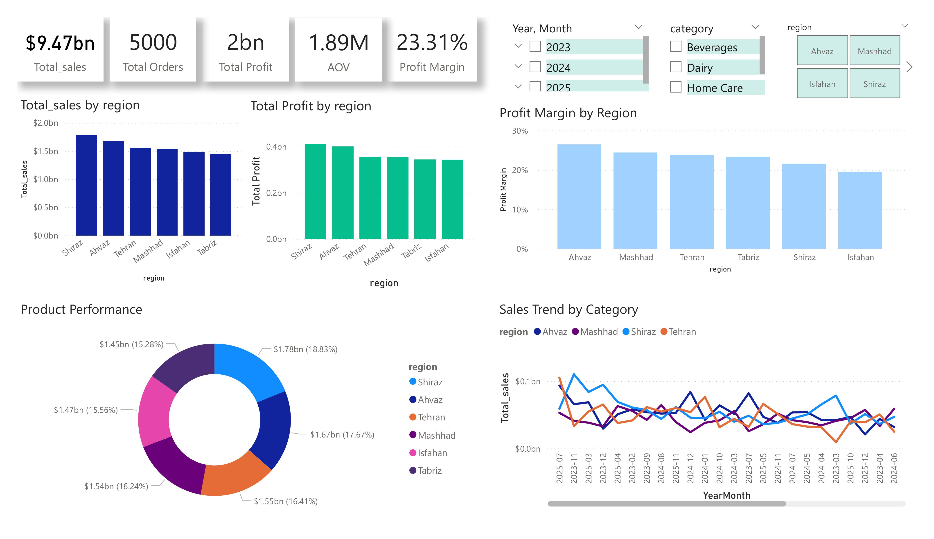
4. POWER BI Stage:
Page 3: Regional / Market Analysis

Slide 30
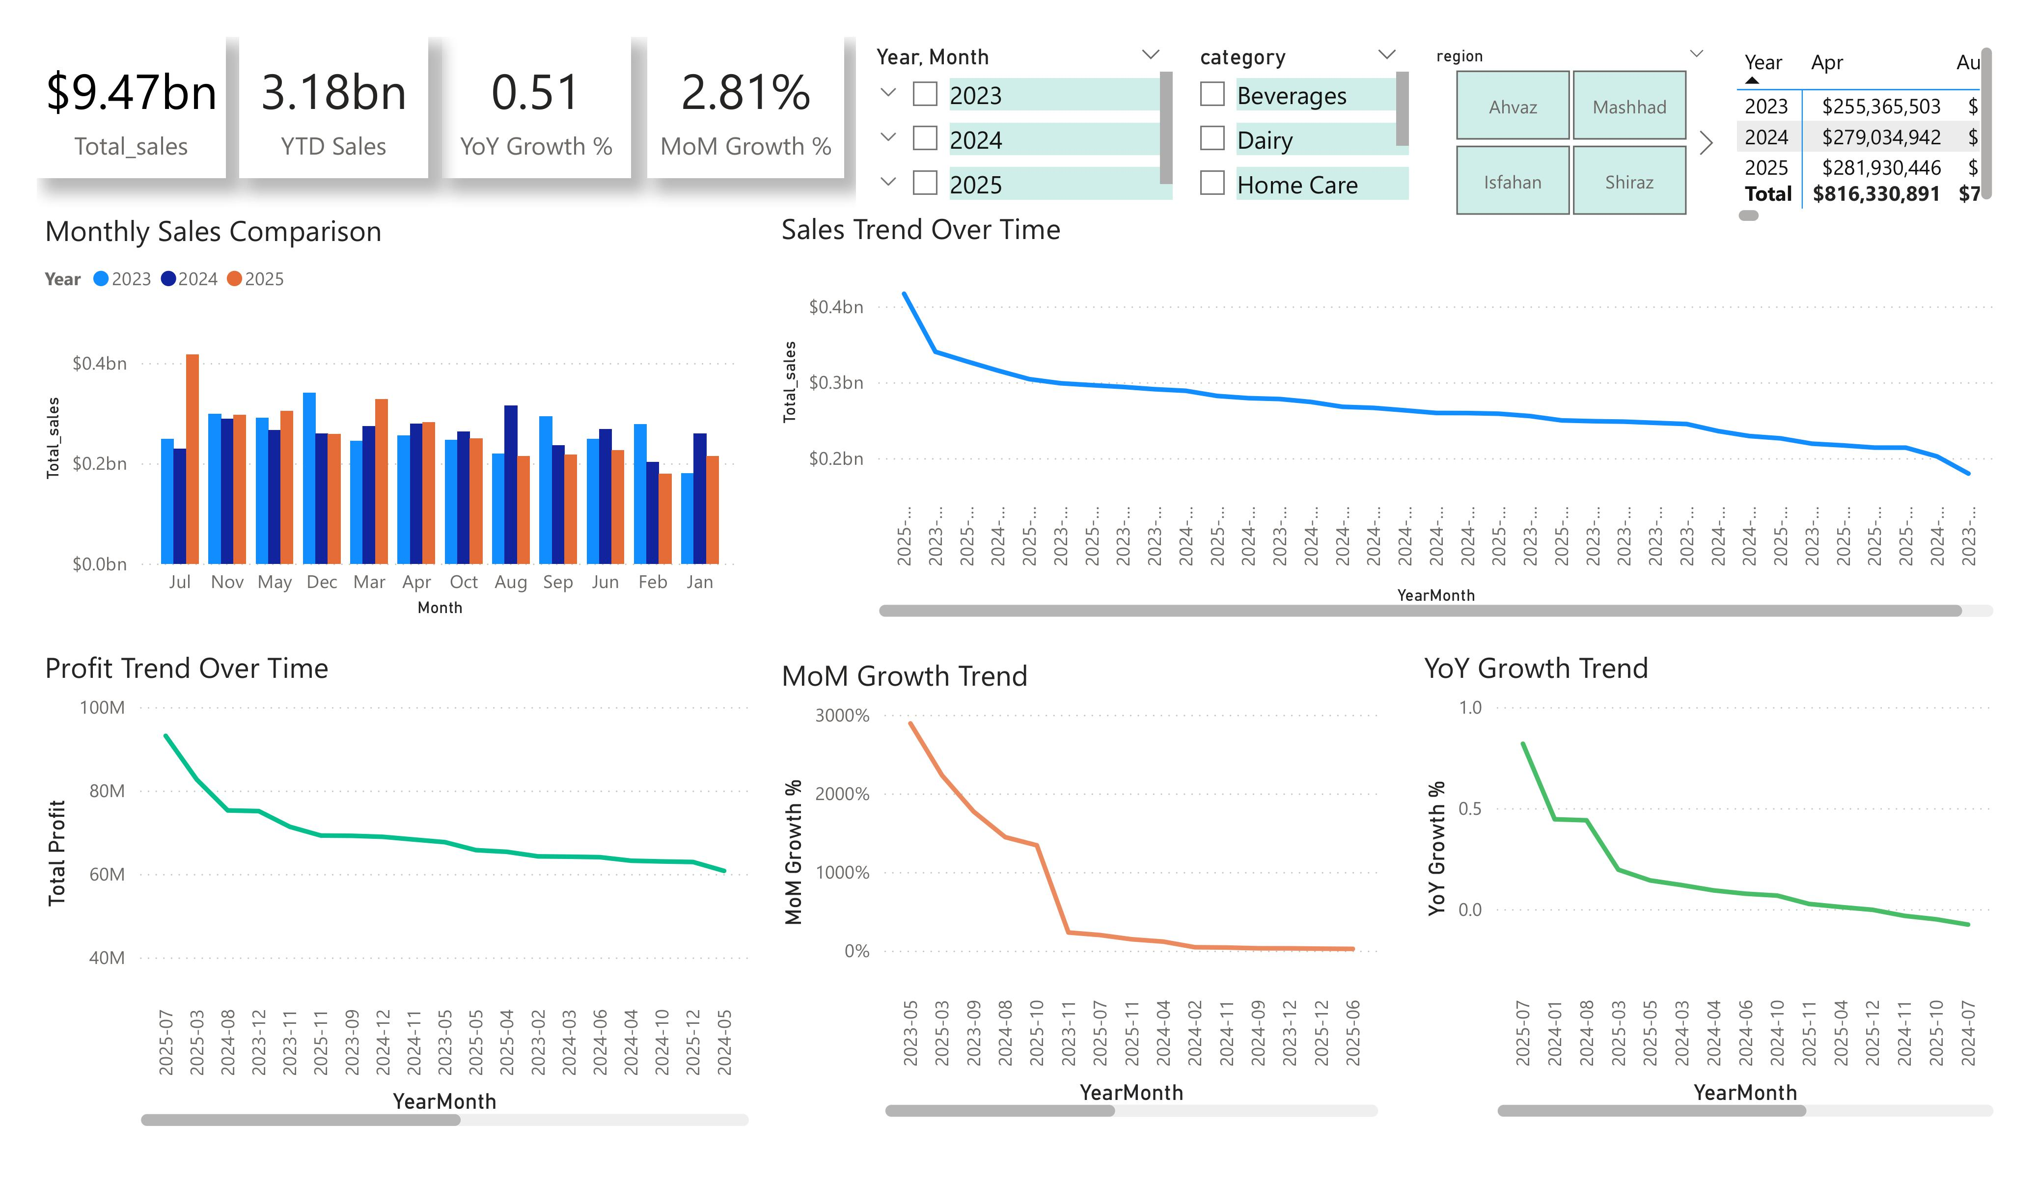
4. POWER BI Stage:
Page 3: Time Analysis

Slide 31
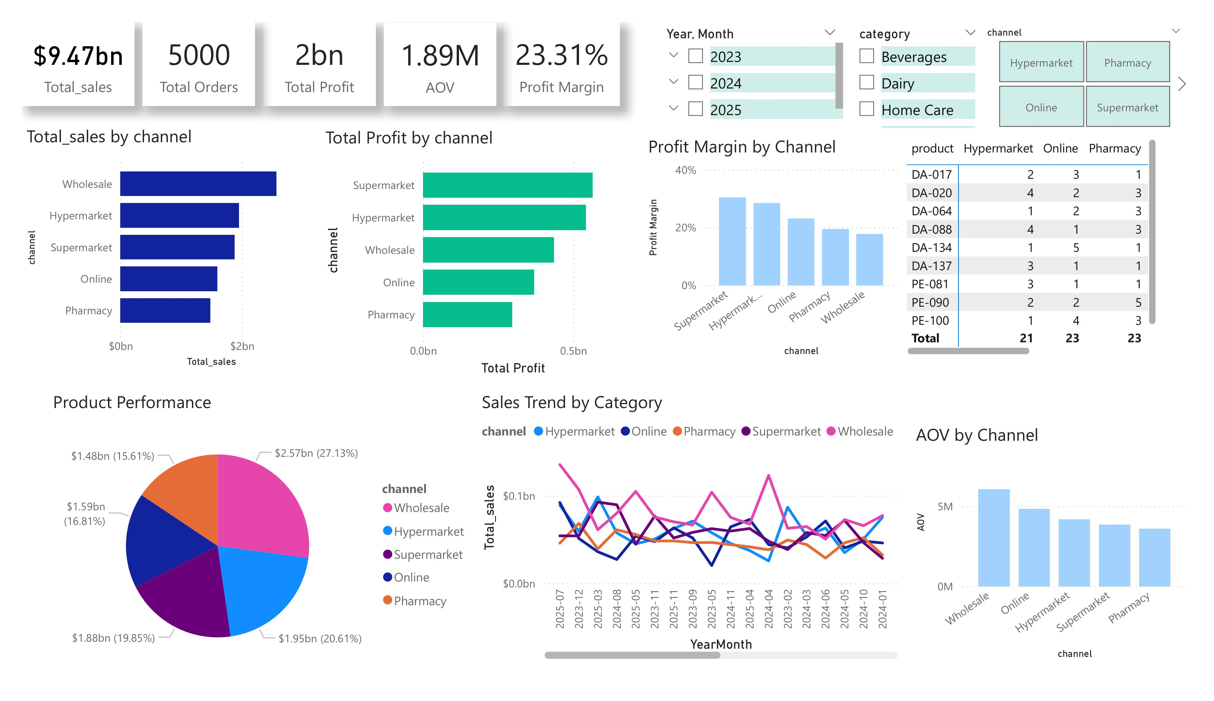
4. POWER BI Stage:
Page 3: Time Analysis

Slide 32
4. POWER BI Stage:
Key Insights:
1. Product Portfolio Optimization (Pareto Efficiency)
Insight: A dominant share of total profit is concentrated in the “Dairy” and “Personal Care” categories, reflecting an 80/20 distribution.
Recommendation: Prioritize inventory management and allocate marketing resources to these high-performing segments to sustain and scale profit margins.
2. Channel & Regional Performance
Insight: Significant variability exists in profit margins across sales channels (e.g., “Supermarket” dominance) and regional performance (e.g., strong sales in “Shiraz” and “Ahvaz”).
Recommendation: Reallocate advertising budgets toward high-margin channels and scale regional best practices to underperforming markets to balance national revenue.

Slide 33
4. POWER BI Stage:
Key Insights:
3. Growth Momentum & Market Dynamics
Insight: While total sales volume is robust, MoM and YoY growth trends indicate a stabilization period, signaling a potential saturation of current market strategies.
Recommendation: Deploy targeted loyalty programs and promotional campaigns to revitalize customer engagement and stimulate demand in stagnant periods.
4. Operational Efficiency & AOV Enhancement
Insight: “Wholesale” shows the highest Average Order Value (AOV), whereas online and pharmacy channels face operational challenges affecting net profitability.
Recommendation: Implement cross-selling and up-selling strategies within online channels to improve AOV, while optimizing logistics to mitigate operational costs.

Slide 34
4. POWER BI Stage:
Key Insights:
Analysis Pillar | Key Insight | Strategic Recommendation
Product Strategy | 80/20 Profitability Concentration | Focus resources on top-tier categories
Channel Strategy | Margin volatility across channels | Pivot investment to high-margin segments
Growth Trends | Plateauing MoM/YoY growth | Launch demand-generation campaigns
Regional Performance | Diverse regional potential | Scale regional success models nationally

Slide 35
Thank You
Data-driven insights for better decisions.

